Slide 1
FIN 740: Corporate Finance
Topic #5
Interest Rates & Cost of Capital

Slide 2
Outline for this topic
Finish “capital budgeting” decision by discussing how to calculate the discount rate for project valuation
Discuss where interest rates come from
Connection between risk & expected return
Risk premium
CAPM [a model for risk premium]
Bringing it together: the “cost of capital”
Apply tools using “Worldwide Paper” case [again]

Slide 3
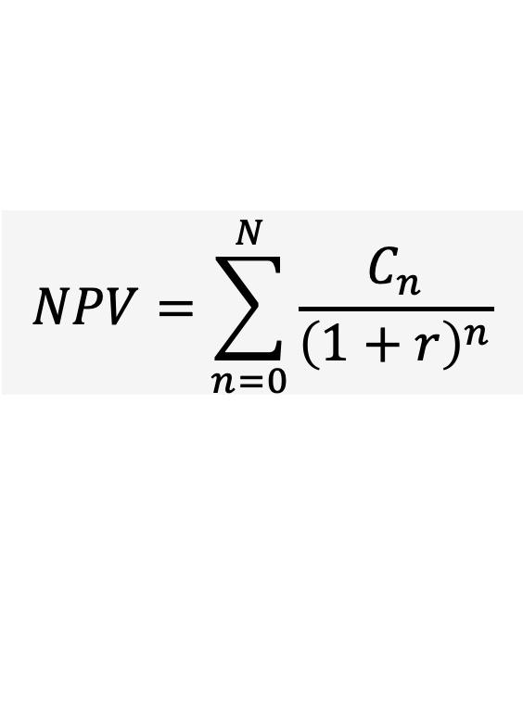
Motivation for understanding the cost of capital
As discussed in last unit, NPV is given by
To date, I have just told you the relevant discount rate… This unit will discuss where this discount rate, r, comes from
$$NPV=\sum_{n=0}^{N}{\frac{C_{n}}{{\left(1+r\right)}^{n}}}$$
As you will see, we also call this r the “required return,” “opportunity cost,” and “cost of capital”

Slide 4

Investor’s required return…
Companies typically raise the money needed for new investments (e.g., new product) using two sources…
Debt
Equity
What factors will determine the return required by each group of investors?

Slide 5
What determines investors’ required return?
Required return = risk-free rate + risk premium
Return they’ll accept if risk-free; [i.e., sweetener offered investor for delay in buying stuff]
Extra bit investors demand for risk
We will now talk about how each piece is determined…

Slide 6
Determination of risk-free rate
Let’s now discuss the first piece of investors’ required return…
Required return = risk-free rate + risk premium
As you’ll see, this piece is determined by market conditions that affect overall “price” of money

Slide 7
Determinants of interest rates
Interest rates (i.e., “price”) are determined by market forces based on the relative supply and demand of money
If supply increases (i.e., more people willing to lend money), “price” falls
If demand increases (i.e., more firms trying to borrow money), “price” rises
What factors will tend to increase interest rates?
I.e., what factors will increase firms’ demand for funds? What factors will decrease households’ willingness to supply funds?

Slide 8
Factor that increases the demand of money
Firms’ investment opportunities
If firms have many good investments [e.g., because they anticipate a strong economy], they will seek to raise a lot of capital
I.e., more firms competing to use money will tend to push up interest rates [i.e., price of using money]

Slide 9
Factors that reduce the supply of money
Risk – Increased risk that investment will not yield a return makes households less likely to lend (i.e., supply) money
Inflation – An increase in inflation will make households less willing to save (i.e., supply) money [Why?]
I.e., increases in risk or inflation will tend to push up interest rates; otherwise, households won’t be willing to supply money

Slide 10
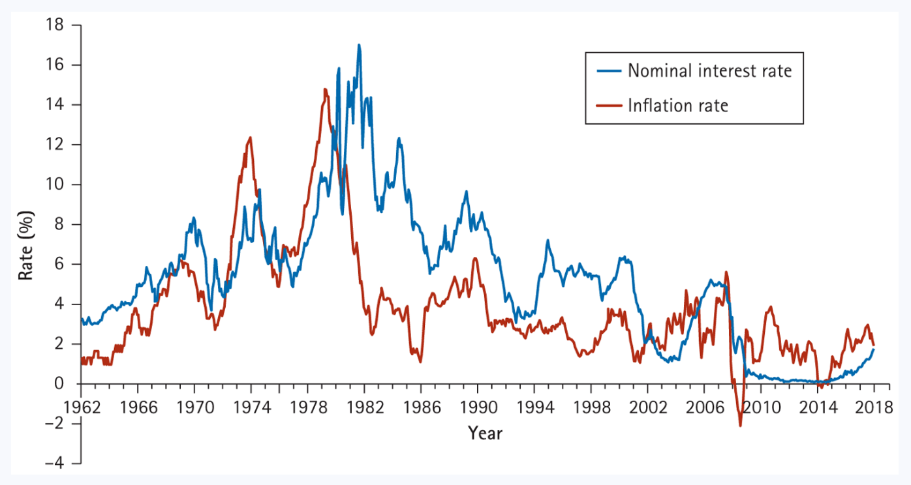
U.S. interest rates and inflation rates, 1962-2018
Figure provides evidence of interest rates responding to reduced supply: When inflation is high, interest rates paid by US government needs to be higher to attract investors’ savings
Figure 5.2: Berk, Demarzo, and Harford, Fundamentals of Corporate Finance, 5th Edition

Slide 11
Intuition for risk-free rate
It is the sweetener offered to entice households to delay buying stuff and to instead supply money (i.e., save)
We consider US Treasury rates to be risk-free [Why?]
The yield curve reflects interest rates paid by US government for bonds that mature at different points in time

Slide 12
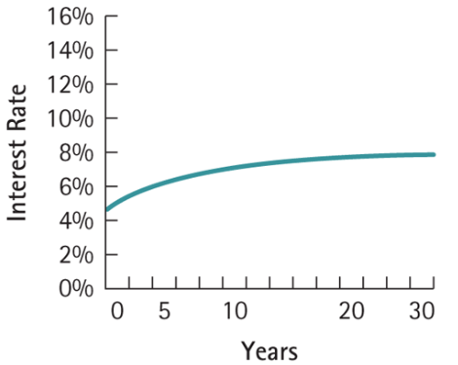
Example yield curve
Typically, yield curve is upward sloping [i.e., US government pays a higher interest rate on bonds that pay off in the more distant future]
Can find current yield curve at:
https://www.bloomberg.com/markets/rates-bonds/government-bonds/us
Figure 5.4: Berk, Demarzo, and Harford, Fundamentals of Corporate Finance, 5th Ed.
What does downward sloping yield curve typically predict?

Slide 13
Outline for this topic
Finish “capital budgeting” decision by discussing how to calculate the discount rate for project valuation
Discuss where interest rates come from
Connection between risk & expected return
Risk premium
CAPM [a model for risk premium]
Bringing it together: the “cost of capital”
Apply tools using “Worldwide Paper” case [again]

Slide 14
Connection between risk and return
Increases in risk will increase the risk premium component!
Required return = risk-free rate + risk premium
Individuals will only supply money to riskier ventures if those investments offer a higher expected return!
But what do we mean by “riskier”?

Slide 15
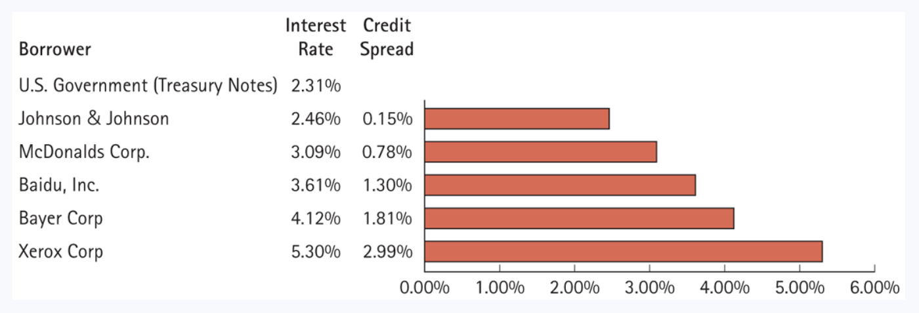
Some evidence on risk & return
Bonds issued by US companies are riskier than US government bonds; so, they will have to offer a higher return
Table 6.5: Berk, Demarzo, and Harford, Fundamentals of Corporate Finance, 5th Ed.

Slide 16
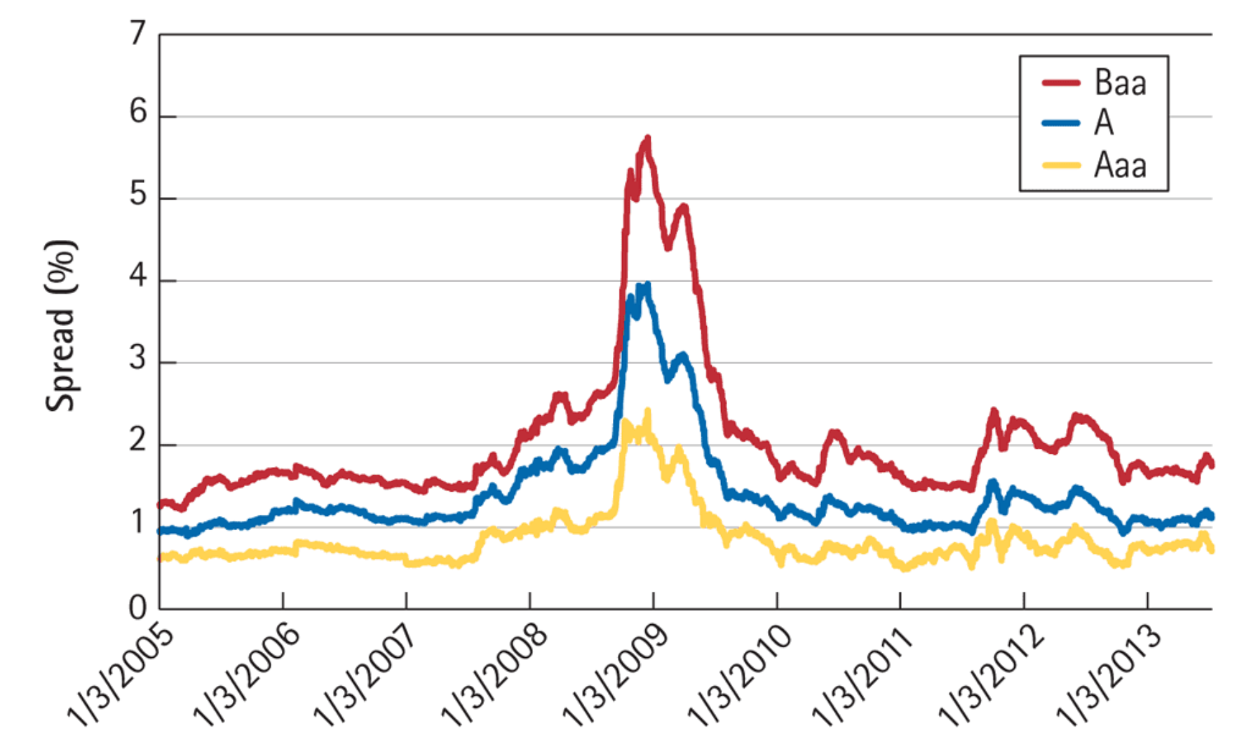
More evidence on risk & return
This figure plots the average risk premium paid by firms with different credit ratings
Aaa-rated firms are least risky, A is riskier, and Baa is even riskier
What is going on 2008-09, and why?
Table 6.6: Berk, Demarzo, and Harford, Fundamentals of Corporate Finance, 5th Edition

Slide 17
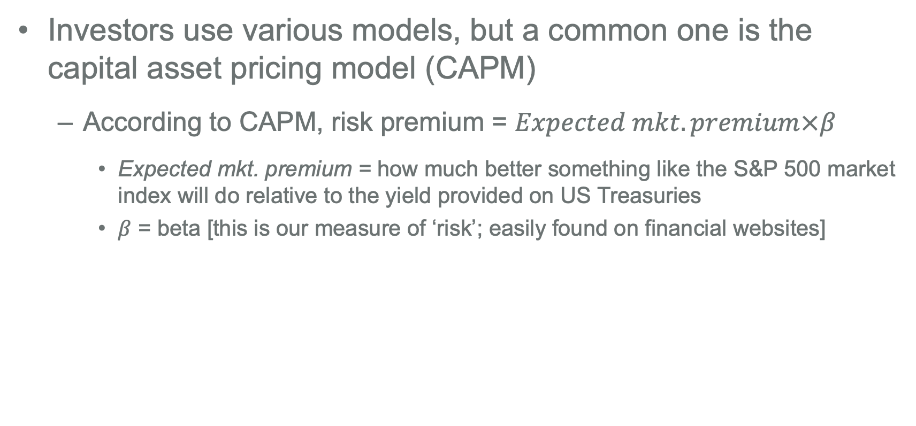
How to find the risk premium?
Investors use various models, but a common one is the capital asset pricing model (CAPM)
According to CAPM, risk premium = $Expected mkt. premium×β$
Expected mkt. premium = how much better something like the S&P 500 market index will do relative to the yield provided on US Treasuries
$β$ = beta [this is our measure of ‘risk’; easily found on financial websites]
Any guesses on what historical market premium has been?

Slide 18

Interpreting the risk premium of CAPM
$Required return=r_{f}+Expected mkt. premium×β$
Units of risk
[Relative measure of risk; e.g., beta = 1 means you have same risk as average risky asset; beta = 2 means you have twice the average risk]
This is premium per unit of risk [reflects the risk premium from holding an asset of average risk level]

Slide 19
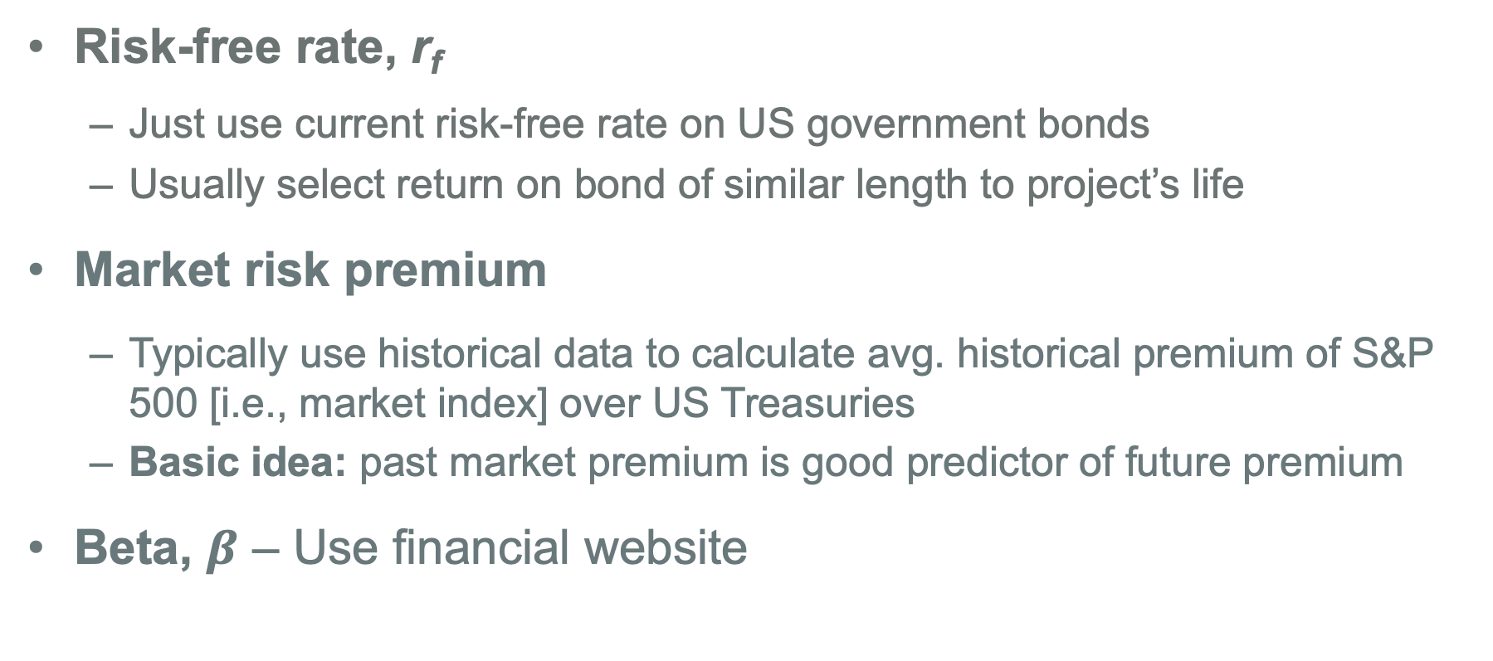
Finding the three CAPM inputs
Risk-free rate, r_{f}
Just use current risk-free rate on US government bonds
Usually select return on bond of similar length to project’s life
Market risk premium
Typically use historical data to calculate avg. historical premium of S&P 500 [i.e., market index] over US Treasuries
Basic idea: past market premium is good predictor of future premium
Beta, $β$ – Use financial website

Slide 20
A beta is reported for every public stock
E.g., just go to http://finance.yahoo.com
Type in favorite company ticker; see beta reported
You will likely see more on how to estimate this beta and where it comes from in a later course of your program

Slide 21
Outline for this topic
Finish “capital budgeting” decision by discussing how to calculate the discount rate for project valuation
Discuss where interest rates come from
Connection between risk & expected return
Risk premium
CAPM [a model for risk premium]
Bringing it together: the “cost of capital”
Apply tools using “Worldwide Paper” case [again]

Slide 22
Circling back to the discount rate
To attract investors’ funds, a financial manager must offer an expected return at least as good as what investors could get elsewhere for investments of similar risk & length
This return is “opportunity cost” investors forgo by investing with you
Thus, it becomes firm’s “cost of capital” [the return investors demand]
Therefore, it will be the “discount rate” we use in valuation
Why is it the appropriate discount rate? I.e., if NPV < 0 using this discount rate, what would firm be better off doing?

Slide 23
Why the cost of capital is important
If project’s expected return is less than cost of capital (i.e., investors’ opportunity cost), both the firm and its investors would be better off investing the cash in that other opportunity
Investors could earn a higher return elsewhere for similar risk
Same for firm; even if it had cash to fund project, it would be better off investing that cash in the other opportunity of similar risk
For this reason, cost of capital is sometimes called the “hurdle rate”; if project’s return does not exceed hurdle, don’t do it!

Slide 24
Finding the cost of capital for a firm (or project)
As mentioned, firms typically use two sources of funding, debt & equity, to acquire their assets
Let r_{D} equal return demanded by firm’s debt investors
Let r_{E} equal return demanded by firm’s equity investors
Let T equal firm’s corporate tax rate
How do you think we combine these to find the firm’s average cost of capital?

Slide 25
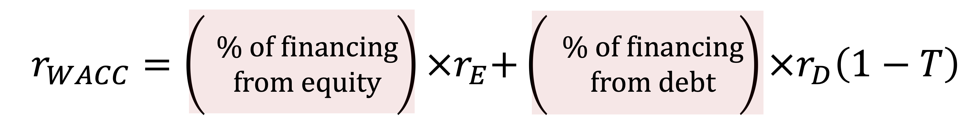
Weighted average cost of capital (WACC)
Weights on two financing costs are determined by how much of each type the firm uses; e.g., % fin. from equity = E/(D+E), where E = value of firm’s equity, and D equals debt value

Slide 26
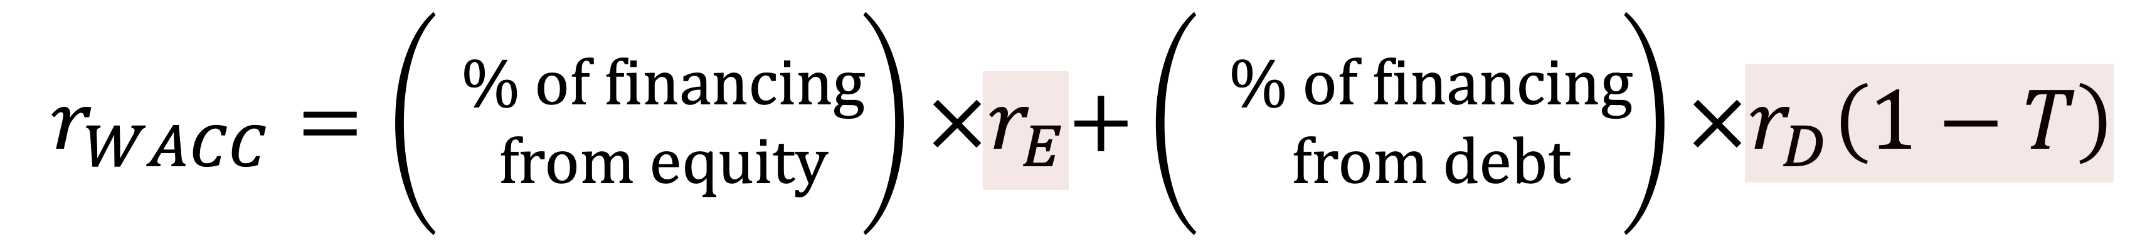
WACC explained [Part 2]
Cost of equity used [i.e., required return of firm’s equity investors]
After-tax cost of debt [i.e., required return of firm’s debt investors, adjusted down for taxes]
Why is cost of debt reduced by taxes?

Slide 27

WACC, cost of debt, and taxes
Firm pays r_{d} to debtors as interest expense
But then saves r_{d}$×$T in taxes [because the interest expense reduces the firm’s taxable income by r_{d}]
Hence, true “effective cost of debt” is $r_{d}−r_{d}T=r_{d}(1−T)$
This is where value created by interest tax shield is captured; remember, we ignored it in estimate FCFs
And because dividends are not tax deductible, there is no tax impact for r_{e}

Slide 28
Interpreting WACC
The cost of capital reflects the required return on the firm’s assets, which sum up to its total capital (debt + equity)
It reflects the market’s perception of how risky the assets are [i.e., riskier cash flows → higher required return demanded by investors]
And it reflects the the mixture of debt & equity used
In making “capital structure” decision, manager typically chooses the mixture to minimize the cost of capital

Slide 29
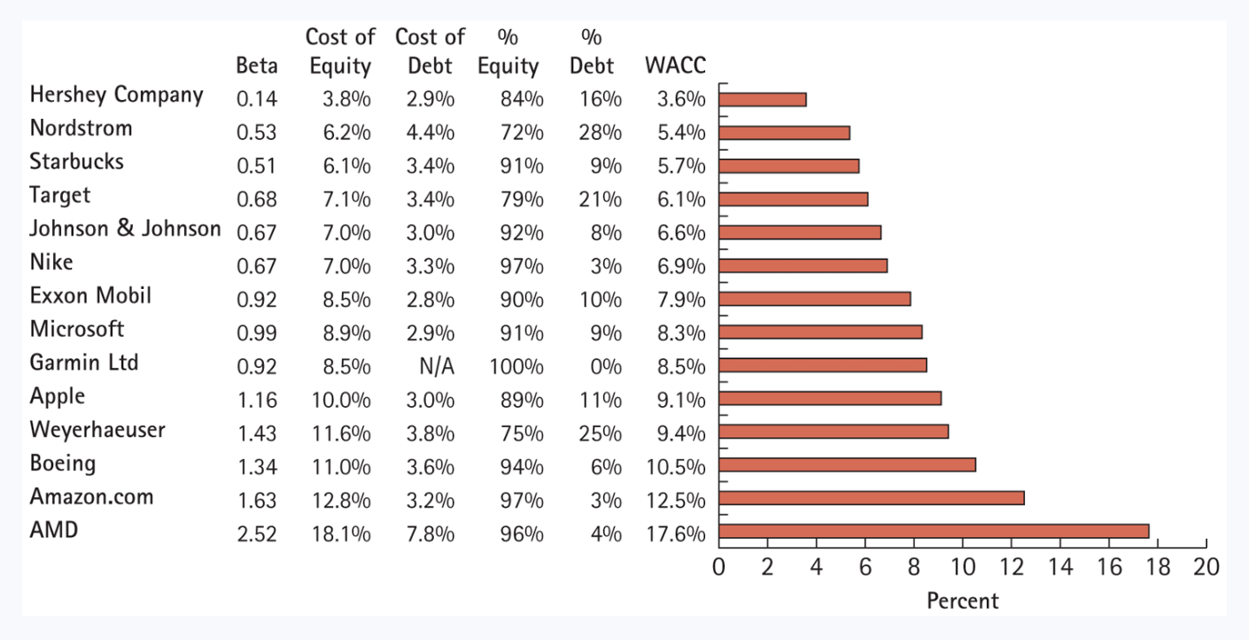
WACC will vary considerably by company
Do these differences make sense? I.e., What causes this variation?
Figure 13.3: Berk, Demarzo, and Harford, Fundamentals of Corporate Finance, 5th Edition

Slide 30
Estimating WACC
When calculating % of financing from debt & equity, use market values of debt and equity
Use forward-looking r_{d} & r_{e} demanded by investors
Typically use CAPM and firm’s equity beta to find r_{e}
Typically use interest rate on firm’s own bonds or that of firms with similar credit rating to find r_{d} [more on how to find this in next unit]

Slide 31
Extending WACC
Can easily extend basic WACC formula to include other types of financing; e.g., if a company also uses preferred stock
Still weight each financing cost by proportion of funding from that source
V = E + D + P, where P is market value of preferred equity
r_{p} = cost of preferred equity
$$r_{WACC}=\left(\frac{E}{V}\right)r_{e}+\left(\frac{P}{V}\right)r_{p}+\left(\frac{D}{V}\right)r_{d}\left(1−T\right)$$
Anyone know how preferred equity is different than common equity?

Slide 32
Group assignment – Worldwide Paper Company
Take 45 minutes to answer questions on the Group Case #4 handout, which is again about the Worldwide Paper Company
In our earlier group assignment, I told you to use 8% discount rate; this assignment will have you analyze whether that was reasonable
Upload answers as MS Excel, MS Word, or MS PowerPoint file to Canvas

Slide 33
Valuing an entire company [revisited]
Now have everything needed to value an entire firm! [I.e., the value of all the firm’s assets & projects]
$$Firm value={Cash}_{0}+\frac{{FCF}_{1}}{\left(1+r_{wacc}\right)}+\frac{{FCF}_{2}}{{\left(1+r_{wacc}\right)}^{2}}+…+\frac{{FCF}_{∞}}{{\left(1+r_{wacc}\right)}^{∞}}$$
WACC is appropriate discount rate when valuing entire firm as it captures average risk of firm’s FCFs

Slide 34
Valuing a project using NPV [revisited]
WACC is the appropriate discount rate for projects of similar riskiness to the firm’s existing operations
But, if riskiness of project differs, adjustments needed
Key takeaway: Discount rate needs to reflect riskiness of the cash flows; i.e., it will be the return the investors (or firm) could get elsewhere on investment of similar risk

Slide 35
Key points to remember about cost of capital
Households are less willing to supply money to riskier ventures; so, riskier investments (or firms) must offer higher return
Required return = risk-free rate + risk premium
Firm’s cost of capital, which we find using WACC, reflects investors’ opportunity cost for investments of similar risk
Hence, firms should only do investment if its return exceeds this cost [I.e., only if this is true will the investment create value]

Slide 36
Where we are going…
Discussion of capital budgeting is now done
Will next talk about how we can value other assets like corporate bonds and stocks using DCF method, which has two steps:
Identify the cash flows from owning that asset
Take present value using correct discount rate
Will also discuss institutional details of these markets
But first, any questions before we move on?

